Slide 1
CT051-3-3 Software Quality Engineering
Software Quality

Slide 2
Topic & Structure of the lesson
What is Quality?
What is Software Quality?
Software Quality Fundamentals
Who is responsible for Software Quality?
Why Software Quality needed?
What are the processes of Software Quality?

Slide 3
Learning Outcomes
By the end of this lecture, YOU should be able to :
  Explain Software Quality
  List and explain Software Quality fundamentals
  Identify people involve in Software Quality
  Explain the common process of Software Quality

Slide 4
Key Terms you must be able to use
If you have mastered this topic, you should be able to use the following terms correctly in your assignments and exams:
Quality
Functional quality
Structural Quality
Process Quality
Transcendent

Slide 5
What is Quality?
Satisfying your customer's needs
Performance upon expectations
Fit for users’ operations
Quality Quotes by “QUALITY EXPERTS”
  Dr. Juran – “Quality is conformance to requirements”
  Dr. Edward Deming – “Quality is a predictable degree of uniformity and dependability, at low cost and suited to the market”
  Mike Robinson – “Quality is meeting the (appropriate) requirement of the customer – now and in the future”

Slide 6
What is Software Quality?
How well a software product conforms to its requirements
Meets the needs of its users
Involves both the software product itself as well as the processes used to develop it.
  From the product perspective
    Quality refers to characteristics like reliability, usability, performance, and security
  From the process perspective
    Best-in-class practices that are likely to result in a higher quality product
In conclusion software quality established from the interplay of people, processes, and technology

Slide 7
Challenges in maintaining Software Quality
Struggle getting complete requirements (e.g., complete, consistent and clear)
Off-track from original specifications
Creating effective and efficient communication within stakeholders
Design errors
Coding errors
Non-compliance processes and procedures
Inadequate evaluation (reviews & tests)
Improper and incomplete documentation

Slide 8
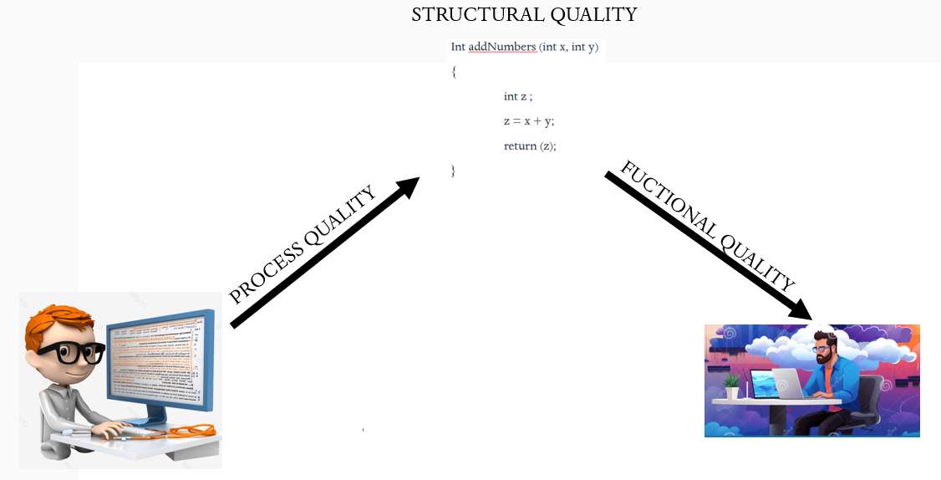
Software Quality Fundamentals
Quality terminology
  Functional quality
    Software performs according to the user’s intention
  Structural quality
    The code organization. It makes testing easy
  Process quality
    Quality of the development process

Slide 9
Software Quality Fundamentals
Major categories of software errors
  Functionality Errors
    The software is not perform as expected
  Communication Errors
    The user have difficulties or issues to use the software
  Missing command errors
    User could not be able to use the software due to expected command is missing
  Syntactic Error
    Misspelt words or grammatically incorrect sentences at GUI

Slide 10
Software Quality Fundamentals
  Error handling errors
    No proper warning message
  Calculation Errors
    Wrong output
  Control flow errors
    Did not show what it will do next and on what condition

Slide 11
Software Quality Fundamentals
Different viewpoints of software quality;
  Transcendent
    This view of software quality where we may have complete satisfaction; However, could not be able to describe or show such as level of satisfaction
  Product-based
    This view of software quality refers to the attributes or features that a software has
  User-based
    This view of software quality, refers to fulfillment of user requirements
  Process-based
    This view of software quality is manifest how the software is conformed to design specifications and development standards.
  Value-based
    This view of software quality, if a software is apparently to be offering good value for the price and community.

Slide 12
Who is responsible for Software Quality?
Quality is everyone in the development team’s responsibility which including customers, requirements, design, development, testing, and support.

Slide 13
Quality issues at different stages of the SDLC
Incomplete requirements
An unfocussed manager - may agree to fuzzy requirement, may result to failure product
Developer misunderstand the requirement, resulting in code that doesn’t meet the customer’s intention.
Communication issues between developer and QA
Inefficient testing - QA engineer may ignore some test case that has worked correctly in the past, leading to undetected issues.
Ignorance DevOps engineer may overlook on some critical script during deployment, causing the software to fail.

Slide 14
Why Software Quality needed
Predictability
  It ensure “Do it once and do it right” concept
  There will be less re-work
  There will Less variation in productivity
Reputation
  Build customer trust
Employee Morale
  Happy employees have pride in their work
Customer Satisfaction
  A satisfied customer comes back business collaboration

Slide 15
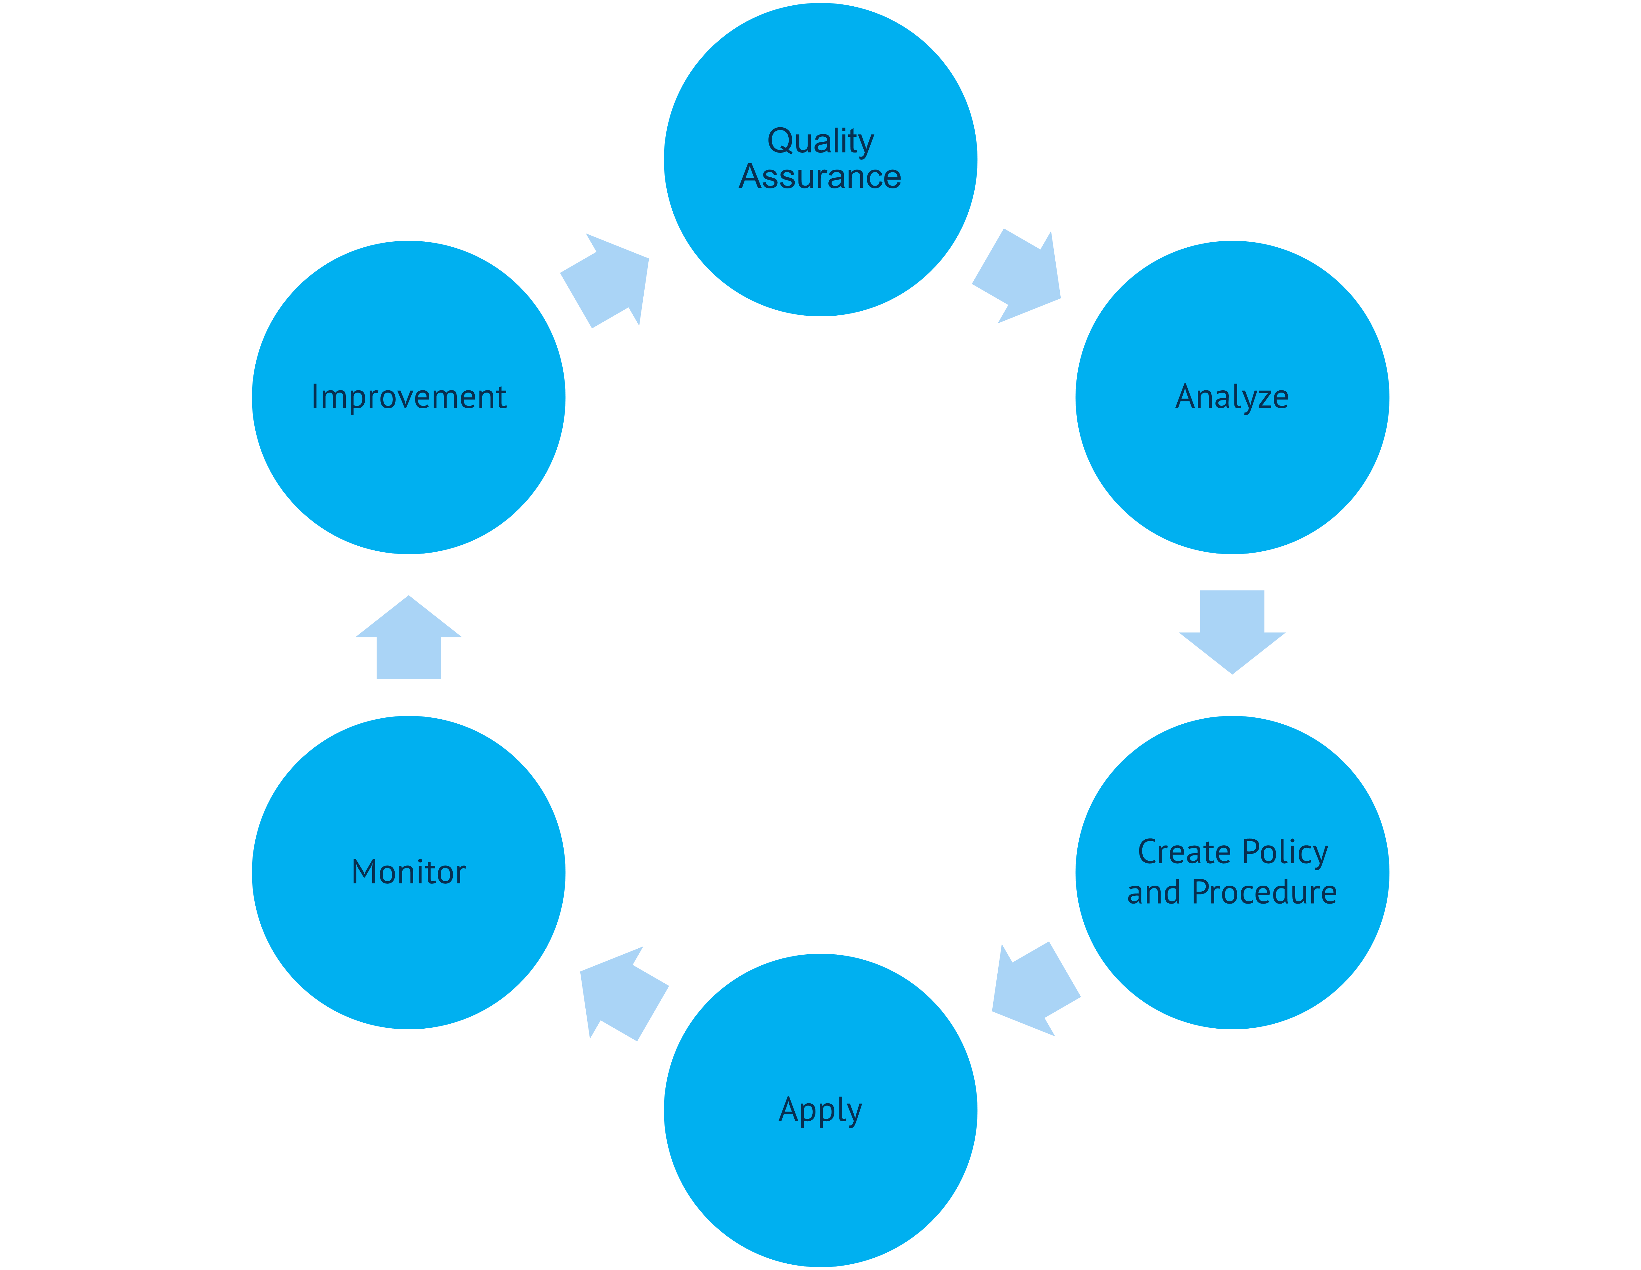
Software Quality Processes

Slide 16
Summary of Main Teaching Points
Quality
Software Quality
Software Quality Fundamentals
Person in-charge for Software Quality
Important of Software Quality
Software Quality Processes

Slide 17
Question and Answer Session
Q & A

Slide 18
Next Session
Process Model

